Slide 1
2nd year review Using genetic data to determine the effect of routinely measured immune cell counts on disease
Student: Andrei-Emil Constantinescu
Supervisors: Dr Emma Vincent, Dr Caroline Bull, Prof Nicholas Timpson, Dr Ben Elsworth, Dr Colin Dayan (Cardiff)

Slide 2


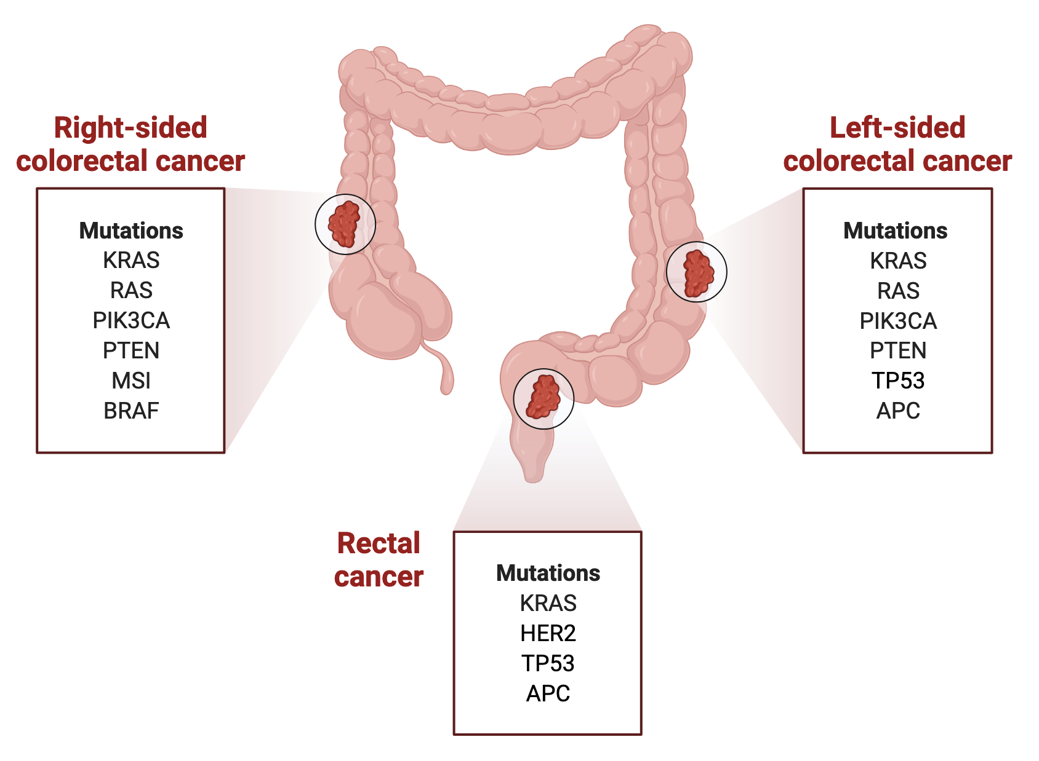
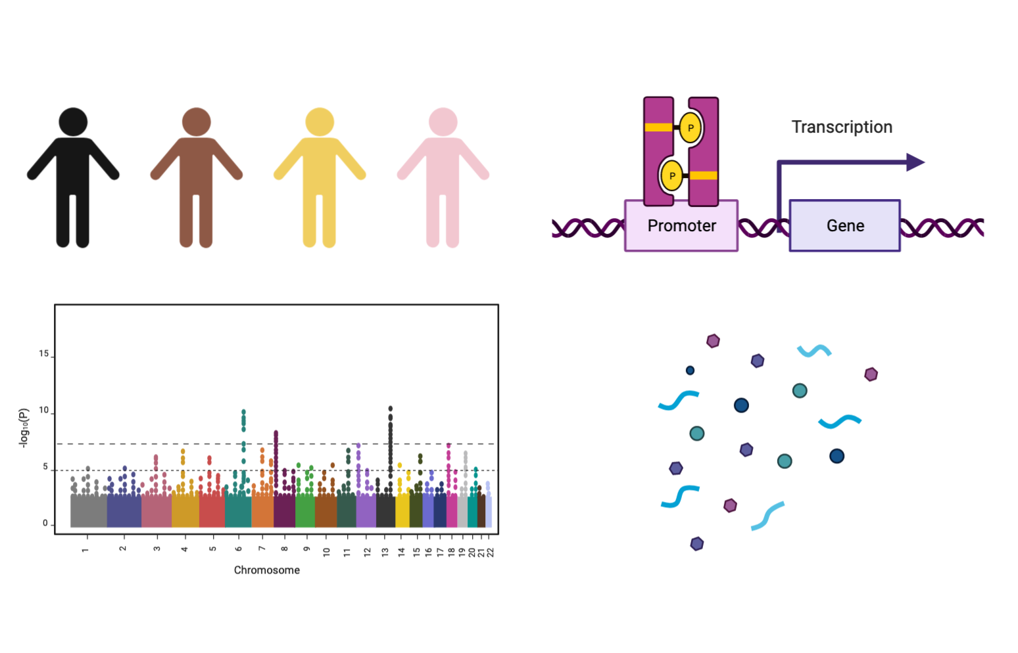
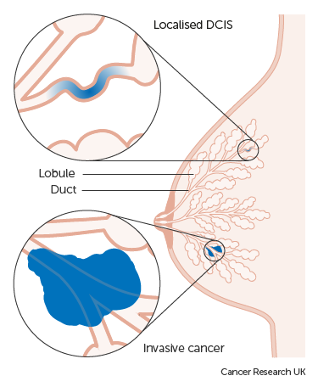
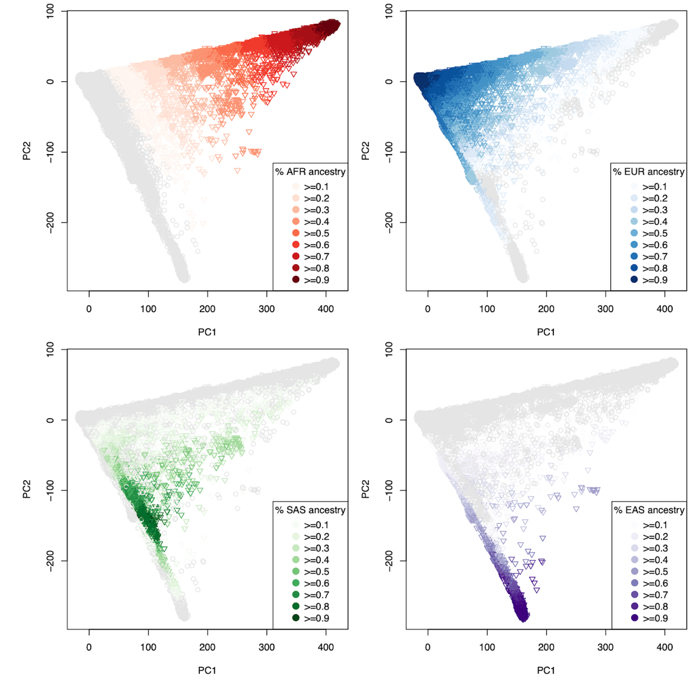

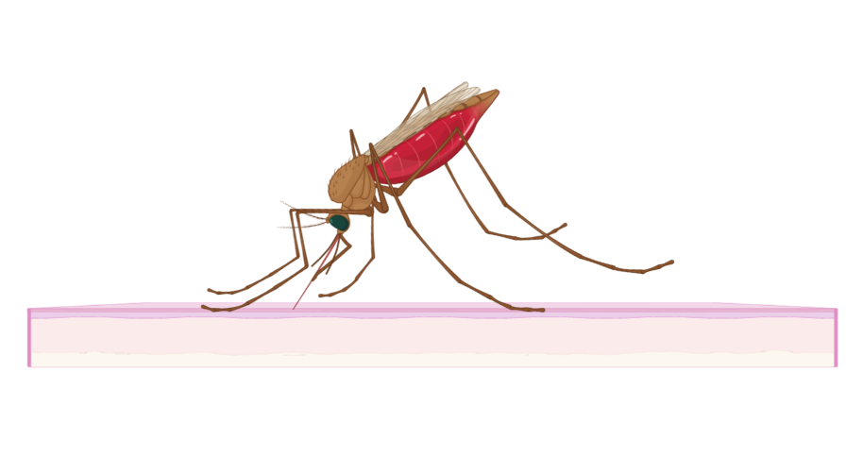

PhD project
Immune cell counts
Colorectal cancer
Breast cancer
Diversity & Human health
UK Biobank continental ancestry
Type 2 diabetes
P. Falciparum Malaria

Slide 3
Summary of my PhD results
 | Title | Status | Publication status
Chapter 1 | Immune blood cell count and breast cancer | Finished | Co-author; bit written-up
Chapter 2 | Immune blood cell count and colorectal cancer | Ongoing | N/A
Chapter 3 | Immune blood cell count and type 2 diabetes | Ongoing | N/A
Chapter 4 | A blueprint for research into continental ancestry groups of the UK Biobank | Finished | Ready for publication
Chapter 5 | Neutrophil count and severe malaria | Near completion | Second draft written-up

Slide 4
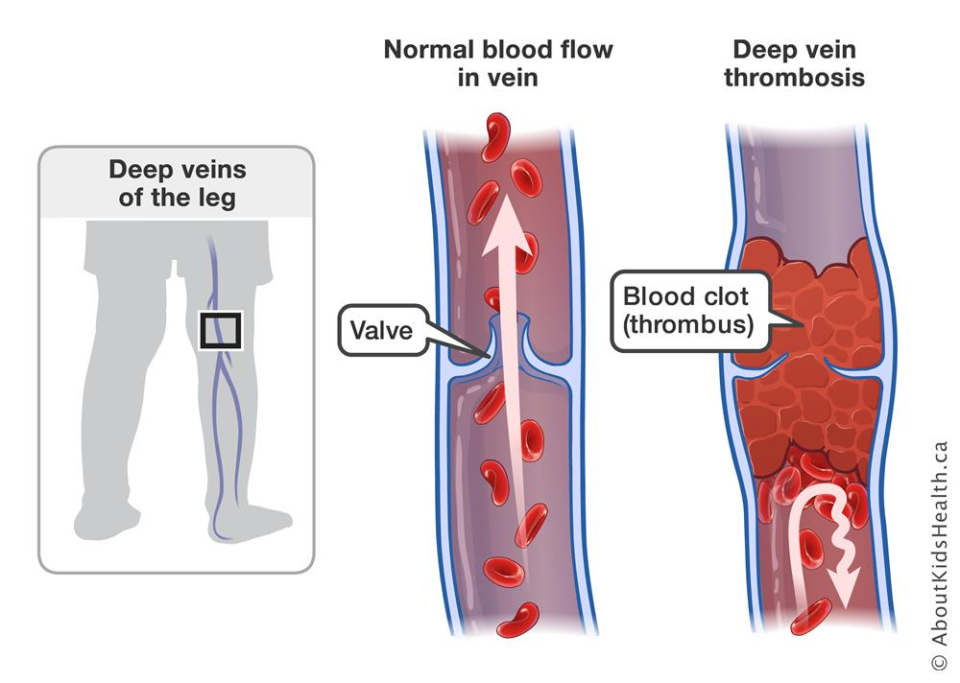
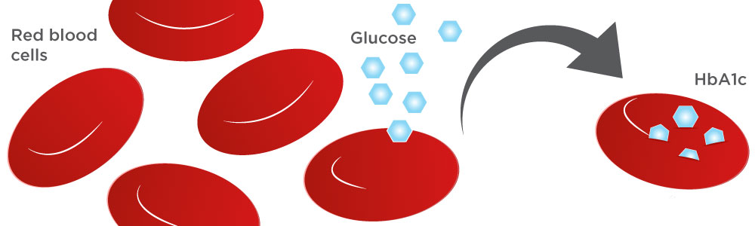
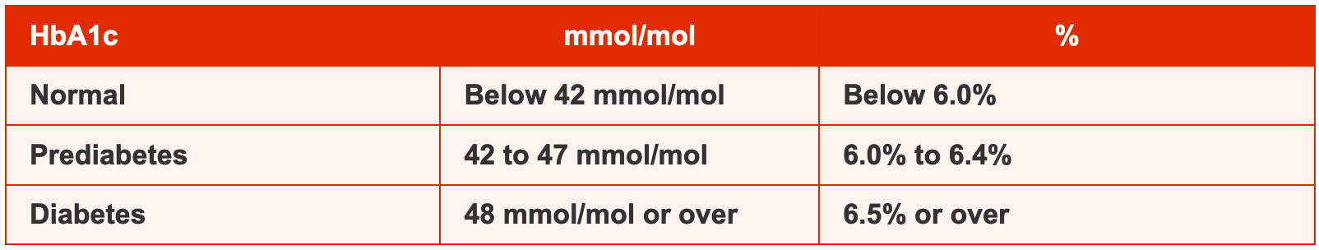
Other research projects
Deep vein thrombosis aetiology
HbA1C UK Biobank GWAS
https://www.ekfdiagnostics.com/res/HbA1c-Hemoglobin-banner
https://assets.aboutkidshealth.ca/AKHAssets/deep_vein_thrombosis_DVT_EN.jpg?RenditionID=19
https://www.diabetes.co.uk/what-is-hba1c.html

Slide 5




Training and teaching
Computational biology of complex disease 3-day course
IKEEP programme: training and placement
Introduction to Statistics short-course teaching module
Flexible Funding application

Slide 7


Acknowledgements
Contact
My supervisors
Dr David Hughes
Dr Ruth Mitchell
Dr Borko Amulic
andrei.constantinescu@bristol.ac.uk
andreiconstantinescu.com

Slide 8
Thank you for your time!

Slide 9
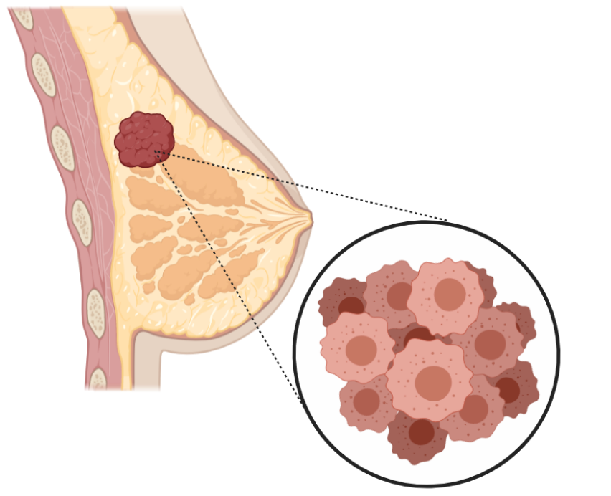
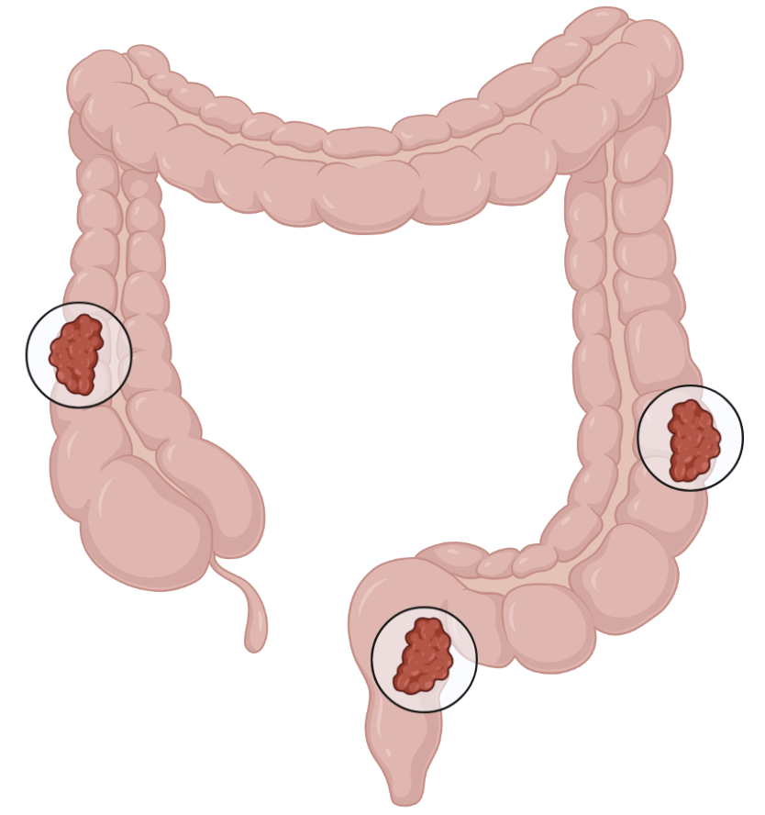
Breast cancer
Colorectal cancer

Slide 10
Type 2 diabetes
Ancestry in UK Biobank

Slide 11



P. Falciparum Malaria
’ukbbmr’ R-package

